Slide 1
ERB Communications Task
10/2/2023
Andrew Stone
CONTROLLED BY: U.S. NAVY, STRATEGIC SYSTEMS PROGRAMS CONTROLLED BY: SP23 FIRE CONTROL AND GUIDANCE BRANCH CUI CATEGORY: CTI, Proprietary Information DISTRIBUTION/DISSEMINATION CONTROL: DISTRIBUTION STATEMENT D POC: Matthew Jamula, mjamula@draper.com WARNING: THIS DOCUMENT CONTAINS TECHNICAL DATA WHOSE EXPORT IS RESTRICTED BY THE ARMS EXPORT CONTROL ACT (TITLE 22, U.S.C., SEC 2751, ET SEQ.) OR THE EXPORT ADMINISTRATION ACT OF 1979 (TITLE 50, U.S.C., APP. 2401, ET SEQ.), AS AMENDED. VIOLATIONS OF THESE EXPORT LAWS ARE SUBJECT TO SEVERE CRIMINAL PENALTIES. DISSEMINATE IN ACCORDANCE WITH PROVISIONS OF DOD DIRECTIVE 5230.25. DISTRIBUTION STATEMENT D: DISTRIBUTION STATEMENT D: DISTRIBUTION AUTHORIZED TO THE DEPARTMENT OF DEFENSE AND U.S. DEPARTMENT OF DEFENSE CONTRACTORS ONLY. ADMINISRATIVE OR OPERATIONAL USE 19 May 2022. OTHER REQUESTS SHALL BE REFERRED TO DIRECTOR, STRATEGIC SYSTEMS PROGRAMS. DESTRUCTION NOTICE: DESTROY BY ANY METHOD THAT WILL PREVENT DISCLOSURE OF CONTENTS OR RECONSTRUCTION OF THE DOCUMENT. THIS PRESENTATION CONTAINS DRAPER PROPRIETARY INFORMATION.

Slide 2
Comms Approach
Provide deterministic and testable communication for guidance and avionics domains that scales with SWS LE2 requirements and future enhancements

Slide 3
High Level Internal Comms Summary
Alternative approaches based on SSDN gaps:
Gaps with flexibility, VSSIM, preplanned slot timing, throughput, reduced IO slip ring count
Increase test capability, concurrent test analysis with tactical timeline
Increase built-in-test capability
The reason we looked at serial bus technologies is because of slip ring count
Analyzed industry standard protocols: MAC-level switched topology still a possible candidate
Take advantage of todays technology with respect to physical layer and increased processing

Slide 4
SSDN Mod1 Selection and LE2 Architectural Deltas
What Drove the SSDN Selection on Mod1?
Started off with higher voltage logic levels in Mod0
Wanted a step change to lower voltage drivers/receivers
Ethernet wasn’t mature at the time. Ethernet was a CSMA/CD design
Needed a rad hard solution that had fast recovery
Strict timing and determinism for the instrument control loops
Limited processing power with multiple distributed single processors
What are the architectural deltas associated LE2?
Processors with orders of magnitude more processing power
Processor chips with multiple cores eliminating the need for multiple distributed single processors
Improvements in high speed SERDES communications including Ethernet
Full duplex deterministic switching topologies with single microsecond latencies
Improvements in driver and receiver technology. Lower SWAP components. Improved edge rates, latencies

Slide 5
Internal Comms Approach
Analyzed existing SSDN for improvements
Greater data flexibility to mitigate SSDN slot rigidity
Reduce software and hardware timing dependencies for data scheduling and computations
Adding full duplex communication
Improving overall bandwidth.
Reduce IO count for slip rings and for cabling
Improve built-in-test
Simplify HWIL and VSSIM slot rigidity and long simulation time due to 2 microseconds slot time
Reduce size, weight and power.
Remove need to preplan slot assignments
Investigated:
Increased need for stellar bandwidth. Interleave stellar with data or provide a separate channel
Timestamp intrinsic to IMU data at point of generation
Fiber vs copper internal – Fiber had larger SWAP footprint
MAC-level switched topology
Possible internal topologies:
Multiple point-to-point internal links
Like LE1 with Middle Gimbal Electronics
Electronics on all Gimbals
Processor in Case Mounted Electronics (CME)
Multiple processors. Processor in CME, processor in MAP/EA
The Details Following will examine a Full Duplex Hybrid Approach that attempts to improve upon the previous design

Slide 6
Lessons Learned from LE
Continued tactical focus with increased focus on test
Allow real-time system feedback and visibility (continuous monitoring and triggering)
Continued and improved focus on HWIL and VSSIM modeling and simulation
Requirement to use general guidance bandwidth for Stellar creates bandwidth restrictions.
Multiple pt2pt interfaces (SSDN, Fire Control, Missile/Flight Control/AMP/TLM/etc) makes test equipment development timely and costly
Reducing custom interfaces to reduce test equipment cost and development time
More emphasis on open standards vs custom hardware
Existence of incompatible data input and logging formats for test tools duplicates effort and complicates development of test tools
Provide capability going forward for capturing all data from any external port (testport and avionics (FC) port)
Reduce complexity of re-configuration of SSDN data for future enhancements

Slide 7
Throughput Analysis - Camera
 | SSS sensor full frame | Bits/ pixel | Bits/ frame | SSS ASIC input frame capture rate (raw data) | SSS ASIC memory to store 10 frames of data | SSS ASIC output frame rate (processed data) | SSS stellar payload data bits/ sec | 8B/10B Overhead | Comms stellar data rate
LE2 | 150 x 150 pixels | 12 or 14 | 315,000 | High-Speed sensor 1ms or 1000 frames/ s | 14 bits/ pixel need 2.7 Mbits of memory to store 10 frames of image data | High-Speed sensor 20ms or 50 frames/ s | 31,500,000 | x1.25 | 39.375mbps
 |  |  |  | 5ms or 200 frames/ s |  | low-Speed sensor 50ms or 20 frames/ s | 5,400,000 | 7,200,000 | 9.36mbps
Comms system should support 1.5x the required throughput to account for processing delays and transmitting/receiving data via DMAs or other means to keep up with 50 frame/sec rate

Slide 8
Requirements
Requirements have been captured for the guidance internal network, mission critical network, high bandwidth network, and TLM network.
Network_Requirements.xlsx

Slide 9
Guidance Internal Network Options Considered
Option | Pros | Cons
Ethernet | COTs solution with common industry use | Requires processor at all nodes.
Min Config TDMA – Half duplex | Added flexibility. Flexible frame/slot configuration Expandable to mission network. | Additional time required for network configuration. Network controller needs logic and access to message dictionary. If used for Mission Network, full SWS timeline not known until full system is configured.
Full Duplex TDMA Stack-Based Design | Added flexibility. Messages added to Tx FIFO when sampled data updates are complete. Expandable to mission network | If used for Mission Network, full SWS timeline not known until full system is configured. Wiring needs to prevent Tx contention (no issue if pt2pt) Full duplex could add complexity on test port if IMU downstream gimbal-gimbal comms are added in LE2
SSDN | Proven Expandable to mission network Predictable, coordinated message dictionary | Pre-programmed message dictionary Limited flexibility, but could be updated to improve

Slide 10
High Bandwidth Network Options Considered
Option | Pros | Cons
Existing Legacy Design | Existing design. Proven at low data rates. | Cannot meet high bandwidth needs
Existing Umbilical Updated with RS422 drivers and multiple parallel wires to get desired bandwidth | No updates to umbilical. Use 10 available umbilical spare wire pairs Can achieve bandwidth between 100Mbps-200Mbps using parallel network design. | No additional bandwidth flexibility unless pins are added to umbilical.
Copper-based Ethernet | Added flexibility with COTs approach Move towards cabling with better impedance control | Network bandwidth still severely limited by copper interconnect and interfaces May not meet desired bandwidth
Fiber Ethernet | Significant bandwidth increase Flexible margin for future needs Comms network will not limit pre-launch timeline Lower weight Reduced SGEMP requirements | Requires novel (potentially costly) umbilical update

Slide 11
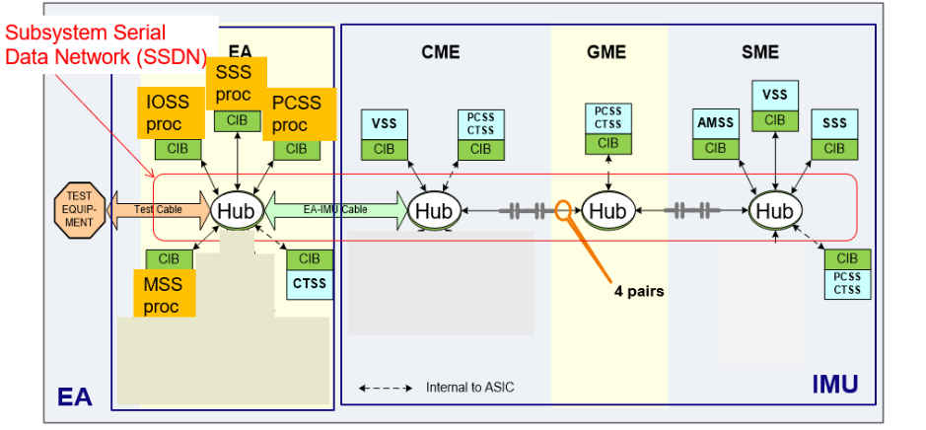
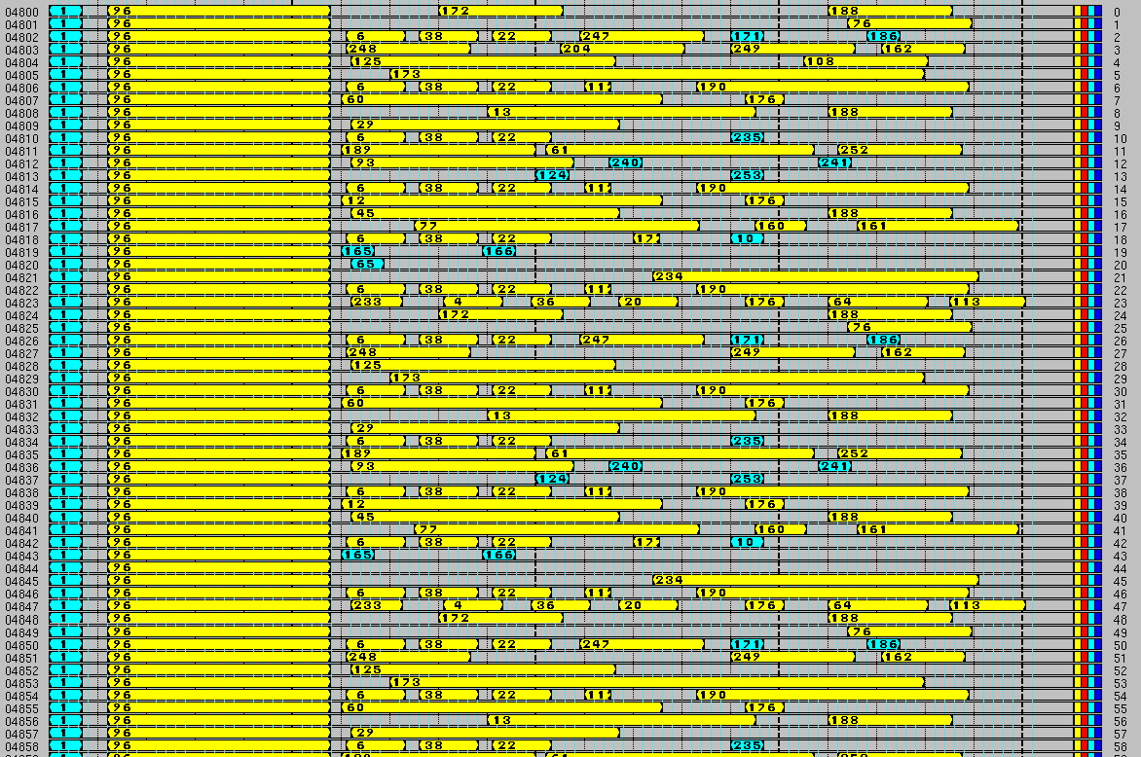
Internal Comms - SSDN
Half duplex, shared bus.
Time synchronization is done by putting messages into slots and frames at specific times.
Slots make the system very rigid.
Stellar Camera intermingled with data. Camera data in original system ~1/3 of total data
Asynchronous messages needed at beginning of C&R to recover reprogramming of system
Changing message size or placement is a complex puzzle. For example, imagine making message 96 larger.
All messages on bus regardless of destination
Testing limited to pre-defined messages with pre-defined functions. Difficulty to add in messages later.
Throughput of current system limited by choice of drivers, transformers and cabling to EA. This can be updated going forward
Uses HB/LB dual channels in each direction. Could be simplified to 1 channel in each direction
VSSIM modeling extremely difficult and causes long duration sims
“SSDN is like dried concrete that you need a jackhammer to remove” – VSSIM Developer

Slide 12
Internal Comms -Full Duplex Hybrid Approach
Full Duplex Hybrid Approach
Sensor data captured on frame and clock offset timing mark – Gimbals, IFOG, PIGA
As deterministic as SSDN is. No need to preplan slots and have a complex ICD
Flexibility:
Greater flexibility for VSSIM and HWIL
Using a small percentage of the bandwidth. Full Duplex frees up more bandwidth
Change the size of messages without having to update the communication HDL and slot allocation
No longer have to pre-schedule slots
Carries forward: 8B/10B encoding, Rad Hardness, C&R fast recovery, Test Port to echo internal data, Frame Timing, Common HDL blocks, Common Driver/Receiver circuitry
Eliminates extra wires needed for Sync by using clever 10bit encoding
Eliminates extra wires needed for GIE/Break by using clever 10bit encoding
Eliminates need for slot timing and complex software/hardware timing dependencies
Data priority scheduling is based on pre-emptive OS, and not on when a particular slot assignment is destined to arrive.
Would use a DMA to transfer data direct to memory for microprocessors
Adds full duplex communication
Improves bandwidth via new physical layer
Add Built In Test (BIT) PRBS generator/checker

Slide 13
Full Duplex Hybrid Approach
Provide a flexible architecture that can adapt to various rate traffic and placement of electronics
Common HDL across all regions
All instrument Data latched on programable hardware timing mark – Gimbals, Accelerometers, Gyros.
TBD storing of hardware sampling timing mark for gimbal electronics if no NVRAM present.
Uses 3 sets of slip rings including a dedicated stellar channel. Includes encoded GIE/Break, Sync. Current LE: 6 sets of slip rings
No risk for HDL approach.
Physical layer requires collaboration with Electronic Parts Working Group (EPWG). No risk. Only risk is if we fall back on existing drivers/receivers. Existing drivers/receivers may not support Stellar BW. Existing drivers/receivers will not support digital clock.

Slide 14
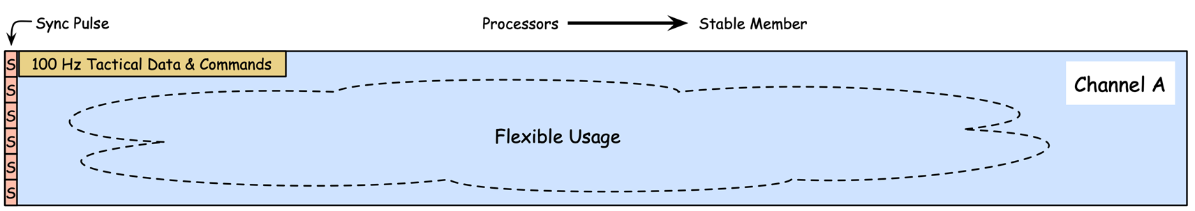
Timing For Link A
6 600Hz Frames
Tactical Messages Sent to Gimbals or Stable Member | 16-Bit Words
msg_MSS_EA_100HZ_MODE_MET | 21
msg_MSS_EA_100HZ_SUBSYS_CMDS | 75
msg_PCSS_300HZ_HTR_CMDS | 4
msg_SSS_EA_20HZ_SSS_SM_DATA | 185
msg_SyncPulseMsg | 10
Messages are received by all electronics like a broadcast via a pseudo multi-drop arrangement
Depending on origin of message (CME vs MAP/IAP) FIFO at CME could provide arbitration
At the 100Hz timeline with 23mbps this provides:
12% of utilization at 100Hz, <1% utilization at other 600Hz
Flexible time could be used for Test or Debug (Command/Response)

Slide 15
Data on Link B
Tactical Messages | Size in 16 bit words
msg_AMSS_SM_100HZ_GYRO_DATA_FOR_MSS | 31
msg_VSS_SM_100HZ_ACCEL_DATA_FOR_MSS | 43
msg_OG_600HZ_RESOLVER_DATA | 40
msg_MG_600HZ_RESOLVER_DATA | 40
msg_IG_600HZ_RESOLVER_DATA | 40
msg_SG_600HZ_RESOLVER_DATA | 40
msg_AMSS_SM_300HZ_GYRO_DATA_FOR_PLAT_CTRL | 7
Diag Messages
msg_VSS_SM_100HZ_RFT_SWM_DIAG_DATA | 133
msg_SSS_SM_20HZ_RFT_DIAG_DATA | 53
msg_AMSS_SM_100HZ_RFT_SWM_DIAG_DATA | 123
msg_OG_100HZ_RFT_DIAG_DATA | 100
msg_MG_100HZ_RFT_DIAG_DATA | 100
msg_IG_100HZ_RFT_DIAG_DATA | 100
msg_SG_100HZ_RFT_DIAG_DATA | 100
TOTAL | 950
6 600Hz Frames

Slide 16
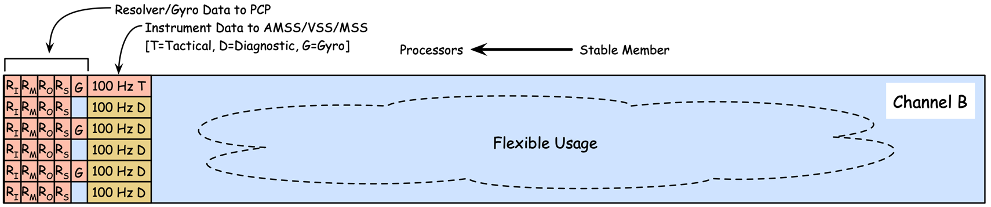
Timing For Link B
6 600Hz Frames
 | 23mbps Typical@600Hz | 23mbps @2400Hz | 96mbps @600Hz | 96mbps @2400Hz
Transmit Time us | 297 | 297 | 71 | 71
FIFO Time us | 74.25 | 74.25 | 17.75 | 17.75
Total Time | 371.25 | 371.25 | 88.75 | 88.75
Percent Utilization | 371.25/1666 =22% | 371.25/416 =89.2% | 88.75/1666 =5% | 88.75/416 =21%
Table above assumes instrument traffic sent at rate listed. See timing diagram
Messages are sent from SM down to Gimbals. FIFOs buffers up whole messages and logic decides whether to send local data or data in received FIFO.
Straightforward HDL logic
Internal FIFO to FIFO transfer rate runs at 4x line rate for minimal latency. FIFO size could be double the worst case to account for future growth
Flexible time could be used for Test or Debug (Command/Response) or the Stellar Channel could be used to return data
This approach provides flexibility to run at any rate with margin

Slide 17
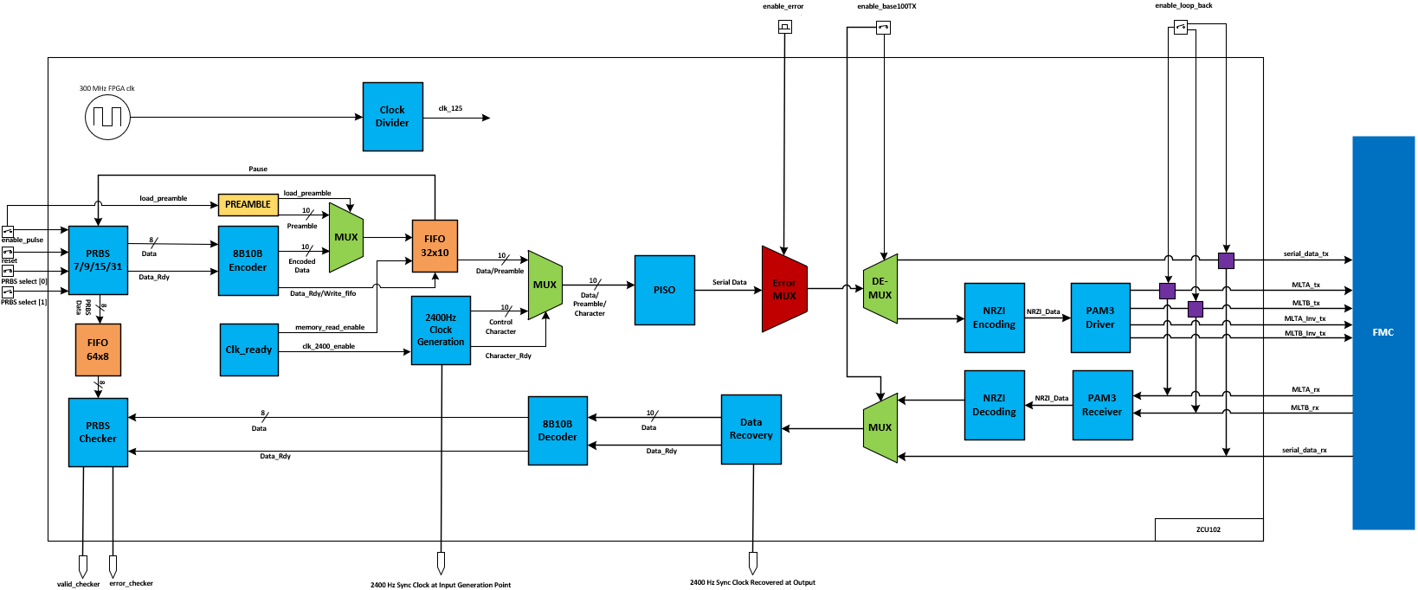
Built-In-Test (BIT) PRBS Block Diagram
PRBS demo circuit designed using the Xilinx ZCU102 FPGA
User interface designed to start and stop PRBS output and check for communication errors

Slide 18
Internal Comms Takeaways and Status
Takeaways
SSDN shortfalls are mitigated by Full Duplex Hybrid Approach
Flexibility for expansion with test
Approach based on today's technology
Built-in-test from the get-go
Integrates discretes such as sync and gie/break into comms
Status
Currently have 3 physical layer boards ready to be built to test physical layer for margins as well as an entire simulation of all guidance traffic.
HDL already developed to test all internal traffic
Have a method to inject noise into system while running built-in-test and/or real guidance traffic models
Have fully functional discrete and sync injection into system
Have fully characterized current slip rings. Measured S-parameter model was used to vet physical layer designs for margin

Slide 19
Physical Layer

Slide 20
Advantages of LVDS-like Communications
Next slides presents only differential communications physical layer options
MLVDS/LVDS offers superior data rate, lower power consumption, and lower EMI emissions than RS422 while being tolerant to large common mode noise (especially in space rad-hard receivers).
Most modern LVDS drivers now have a failsafe built-in feature which sets the output to ‘high’ when input is high-z. This is needed for AC coupled/transformer coupled solutions.
Reduction in power supply noise compared to single ended since output current remains constant. Less need for power supply decouplers
LVDS/MLVDS or LVPECL/CML are the leading contenders
LVPECL and CML offer a larger output swing voltage. Results in lower jitter, but higher power consumption. May offer improved EMI susceptibility.

Slide 21
Internal Comms Physical Layer Standards Evaluated
Standard | Power (mW) (single channel) | Data rate (Mbps) | Voltage Output Swing min (mV) | Rx Input Threshold (mV) | Common Mode Input Range (V) | Skew (ns)/ Propagation Delay(ns) | Features | Complexity
RS422 | 100 | 30 | 2000 | N/A (LVDS rx) | N/A (LVDS rx) | 10/70 |  | 8b10b
MLT-3 | 200 | 100 | 2000 1V per symbol | 200 |  | 200ns | Reduced BW | Voltage encoding + 4b5b or 8b10b
LVDS | 45 @ 100 MHz | 400 | 250 | 50 *commercial go lower | -4 to 5 | 0.6/4.5 | Failsafe Bias | 8b10b
MLVDS | 17mA | <200 | 480 | 50 *commercial go to 35 | -1.4 to 3.8 | .6/10 | Detects open circuit for failsafe | *could not find any space rad hard *use as pt-pt
CML | 180 | >1000 | 650 | 200 | 1.5 to 2.4 | 0.1/1 |  | 8b10b
LVPECL | 82 | >1000 | 1100 | 200 | 2 to 3.2 | 0.05/.45 |  | 8b10b

Slide 22
Internal Comms System Requirements
Future enhancements in compressed schedule
Enhanced data logging with test equipment
Timing:
CTTS to generate and distribute Ref_Clk to all GS modules, within 100 us after release of PFI with less than 1 ns cy-cy RMS Jitter
REF_CLK tunable oscillator will be locked to Fire Control timing during prelaunch and held during flight with TBD ppm accuracy
Internally generated Sync is synchronized with Nav 1PPS
GS modules to receive Sync with less than 200ns of skew and less than 200ns p-p jitter
Sampling:
Subsystems will receive timing information for instrument sampling
Less than 200ns of Sync Pulse skew in all regions
Sampling of the instruments needs to be on the same time mark every time
Resolvers and Gyros need to be sampled on the same time mark within 5us (TBD)
Torque motor commands/direct torque needs to be sent on the same time mark every time

Slide 23
Internal Comms System Requirements Cont’d
Recovery:
Transmit reference clock and any needed discretes as soon as power is stable to allow IMU ASICS to start sampling instruments and generate data to transmit on comms infrastructure
Manage and synchronize the release of PFI (System Reset) to all subsystems
Meet similar LE ~2.5ms circumvention and recovery timeline. 3-7ms for flight control
Slip Ring and wiring Spec’d out for controlled impedance and return/insertion loss similar to IEEE 802.3 100BaseTX spec
Every message sent in the system is recorded. This can include inter processor core messages.
Support a Bit Error Rate for error free comms within a TBD hour period of time in the presence of an additive white Gaussian noise distributed over a bandwidth of 1.0 kHz to TBD MHz at a RMS amplitude of 140 mV
Derived into jitter requirements
Needs additional assessment
Maintain galvanic isolation between guidance regions
SGEMP transients, per OD 64856 in cases where the Subsystem has a direct connection to any of the following external connectors

Slide 24
Avionics Network

Slide 25
Managed Systems Communication Approach
Established a systems approach to the network design (Physical Interface to Application)
Fully characterized communications for current and future enhancements
Complete understanding of all data paths and requirements
Established HW/SW element capabilities and characteristics
Software/Hardware latency, BW, timelines, timing and synchronization
Understood network environment/topology/data paths that are static
Established a common API for all software developers to access the communication bus:
Software developers shouldn’t need to know or need to understand the systems approach to the network design
Common API locks down features such that the network is predictable and reliable.
Real-Time monitoring of network configuration and status/errors
Future expansion
Predictable system margins throughout D5-LE program with new network node reallocation or new network node additions
Command Response for real-time test and diagnostics
Test integrated with internal comms timelines

Slide 26
High Level Avionics Comms Trade Summary
Review of industry standard protocols:
Ethernet and supporting protocols on top of Ethernet – DDS, LCM, Time Sensitive Networking, SNMP, ARINC 664
SpaceFibre
Point to point protocols like: Aurora, interlaken
Other protocols quickly ruled out: CAN, 1553, EtherCat, Time Triggered Ethernet (TTE)
Analysis of optics based physical layer vs copper
Ongoing trade on copper technologies
Very thorough trade almost complete on fiber optics technology
All protocols and physical layers examined for Trident specific requirements:
Strategic Rad Hard
Startup Timelines
Mechanical and environmental
Recommendation is: Switched Ethernet over integrated fiber optic transceivers to support both high speed and real time communications
SSDN on Avionics network is not flexible, scalable and very difficult to use
Ethernet Approach will be fully characterized from API to API

Slide 27
Fiber Optics Trade Study
Fiber optics offers clear advantage over copper for the following reasons:
Immune to electromagnetic interference and does not generate EMI
Long distances up to 550 meters
Radiation hardness of fiber optic cabling
All components evaluated for the following criteria:
Mechanical shock/vibe
Radiation Hardness
Circumvention and Recovery Time
Auto test/ monitoring capability
Optical link budget, power consumption, data rate, commercial maturity
Evaluated transceivers:
Includes VCSEL or other laser drivers
Evaluated fiber optic cabling
Evaluated multimode vs singlemode. APC vs UPC
Evaluated fiber optic connectors
Evaluated backplane connectors
Evaluated high insertion military connectors

Slide 28
Fiber Optics Summary/Recommendations
Transceivers:
Samtec FireHawk or Smiths SpaceABLE are built on a radiation hardened process technology
Samtec FireHawk extensively tested in the lab. Ran for 2.5 days at 1gigabit with 0 errors. Optical tests pass all IEEE standards with ample margins
Samtec FireHawk process technology reviewed by Steve Hoeschele and says it is a good candidate.
Both include VCSELs, which are the most desirable for radiation hardness (details in report)
Fiber optics
Model | Vendor | Rad | Vib | Circumvention Time | Commercial Maturity | Form Factor | Optical Specs | Data Rate | Power Monitoring
FireHawk | Samtec |  |  | <1.2ms |  | Quad XCVRPCB Mount | 850, MMF | 1/10Gbps | Yes, SPI
Name | Vendor | Radiation induced attenuation -RIA (db/100m) | Fiber Type | Commercial Maturity | Core Attenuation (db/Km)
Super RadHard | Prysmian Group | 4.7@ 850nm*** 2.2@ 1300nm | MMF |  | 2.6@850nm 0.6@1300nm

Slide 29
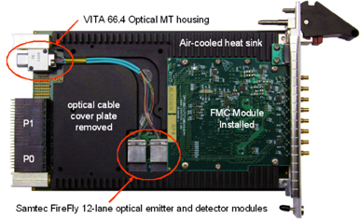
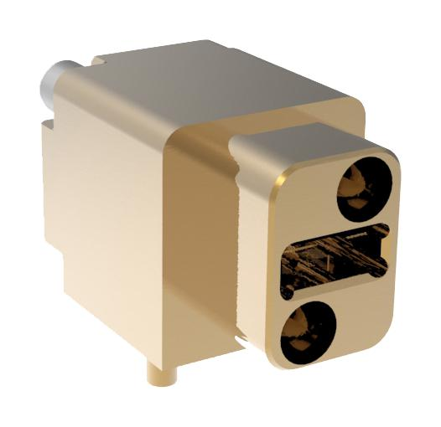
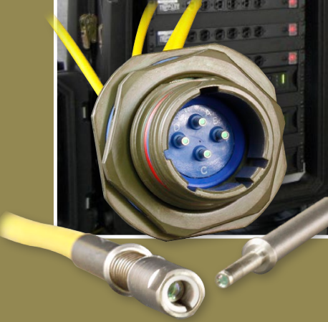
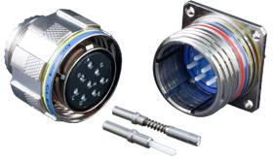
Fiber Optics Summary - Connectors
Fiber Optic Backplane Connectors
Use VITA 66.4 or similar
High Insertion Count Connectors:
Use GlenAir Eye Beam GLT.
Expanded Beam with alignment
Low Insertion loss Connectors:
38999 connectors with ceramic ferrules

Slide 30
LE2 PDU External Comms Objectives
Support existing LE requirements
Support systems integration with hardware in the loop
Support new CONOPS
Fire Control to RB Prelaunch – Allows for shipboard prelaunch initialization
In Flight Guidance RB alignment – continuous ~100Hz data between Guidance and RBs
Timing/Timeline Sequencing/Control
Large data file transfers to RBs, without affecting real-time communication
Missile-to-Missile direct comms
Receipt of full 16Hz Nav Data
Logging of guidance and avionics subsystems data. Cloud storage/analysis?
System Support and Deploy future enhancements with REDUCED schedules:
Modularity, commonality, enhanced test, cyber mitigation
Data Adaptability to handle new RBs and internal guidance changes
Improved testability and continuous monitoring
Use logged/real-time data to rapidly assess failures, health, welfare and performance of the system
Future Mission Applications

Slide 31
LE2 Expected Ethernet Recovery Timeline
-1 ms 0 ms 1 ms 2 ms 3 ms 4 ms 5 ms 6 ms 7 ms
50 us
105 us
285 us
3 ms
4.03 ms
7 ms
185 us
200 us
0s: Processor reset is released; recovery begins.
50 us: Security Engine completes Fast Boot; Omaha cores enter Recovery Init state
105 us: Recovery Init state completes; Mission early recovery & ethernet stack init begin in parallel.
185 us: Configuration of PHY layer complete
200 us: MSS Early Recovery complete (estimated)
285 us: Configuration of Omaha internal registers and memory complete. Programming of Fiber XCVR
1.4 ms: Fiber optic transceiver operational
3 ms: Required minimum delay after release of reset for completion of MDB transmission to FCEA
4.03 ms: MOD 1 observed time after release of reset for internal transmission of MDB from MSS to IOSS
7 ms: Required maximum delay after release of reset for completion of MDB transmission to FCEA;
Mission hardened object repair completed.
8.5 ms: MSS recovery complete (not shown on timeline)

Slide 32
Fast Boot & Ethernet Stack
Reconfiguring network after reset using saved configuration requires writing a few dozen regs on GRadSoC processor & PHY chip
Exact number depends on PHY chip selected.
PHY chip connected by 10MHz SMMI bus; est time for 50 16-bit regs: 80 us
Message stack can be tweaked for a zero-copy approach
Eliminates need for final copy on Ethernet
Total boot time for an ethernet stack in recovery is expected in the low 100s of us & can be done in parallel w/ Mission startup & MDB generation

Slide 33
Avionics Network
Spare Ports on Switch for future payloads

Slide 34
Timing and Determinism of ENET
Mission Network Is Not Needed
Ethernet approach supports both file transfers to RBs and real-time comms
Single packet exceeds the current interface for latency
From an Application to Applications viewpoint there are 4 areas of arbitration and management:
Scheduling priority of tasks
Optimize the task priorities
Possible - assigning single core to IOSS functionality
Single microsecond latencies through a layer 2 switch
Does not use IP switching, only MAC level switching
Streamlining the stack code
Optimize the stack code configuration
Managing a Queue of messages
Encapsulating data into a single message – no queuing in switch
Common API(s) that are shared amongst contractors
Characterization of Application to Application (AP2AP)
Scalability and Flexibility
All Current Conops will be fully characterized and allows for future margins and future conops
To introduce new Conops the only modification required is to the API
Physical layer, stack, network switch latencies will be fully characterized

Slide 35
ENET Timing Diagram – Fire Control

Slide 36
ENET Timing Diagram – 100Hz Avionics

Slide 37
ENET Timing Diagram – Internal Guidance Echoed to Avionics ENET
Built-in Comm Emulator
All data contains frame numbers and 64bit time tags

Slide 38
Middleware Tactical Data Flow Diagram
Missile Internals
Guidance
System
Reentry
Bodies
Fire
Control
Timing Discretes
Middleware Data Bus
Nav Data
Flight Control
TLM
Interface
Data
Recorder
GS/FC Comms
RB Comms
Diag Data
TLM Data
GS/FCEA Comms

Slide 39
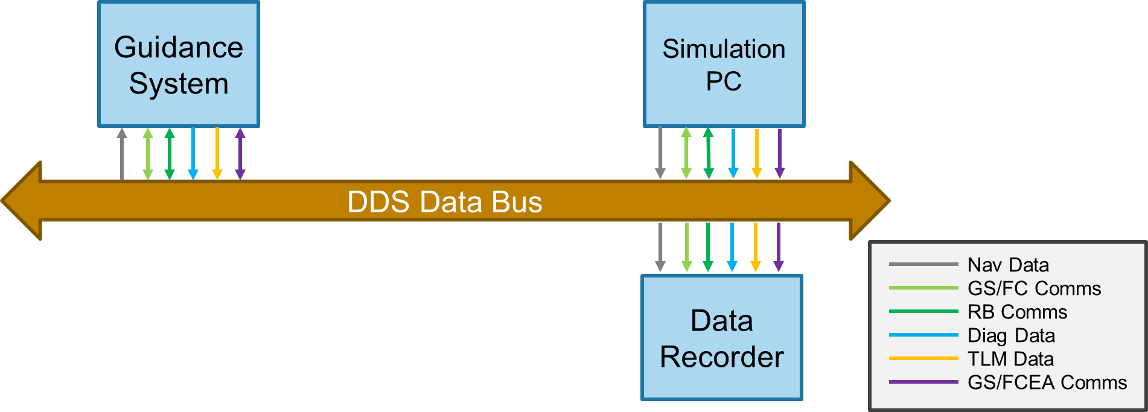
Data Logging/display
Guidance system itself would become like a comm emulator giving you direct visibility into system over a user friendly ethernet interface.
A laptop could be connected for data logging or data display to test port or to avionics port. Laptop could be used to drive testing.
Timestamping could be intrinsic to internal IMU data at the source
Data generated on the internal bus would be bundled and echoed out of the test port/avionics port
With middleware technology, simply subscribe to data stream for internal IMU comms, or become a publisher of test data destined for internal IMU

Slide 40
Coordinated Interface and Data
Application Layer
Common Coordinated API across Avionics Network and Shipboard
Middleware Layer
SWS Priority based traffic manager, data dictionaries
Timeline management, Data logging, Data Visibility, Test Hooks
Transport, Network, Link
Testing and profiling of MAC/PHY hardware layer
Testing and profiling software stack implementation of Network Layer
Physical Layer
Testing and characterization of physical layer
Bit Error Rate (BER) and SERDES link compliance

Slide 41
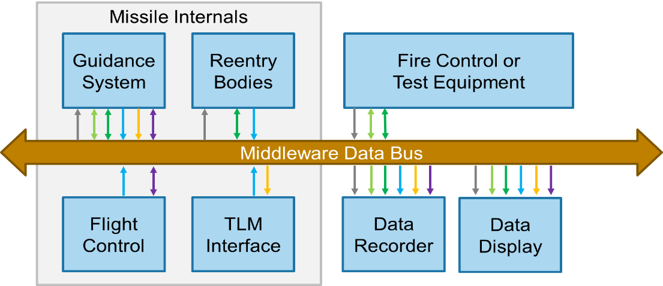
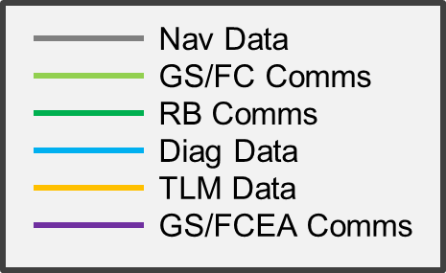
Test and Integration
Common middleware API to support tactical data as well as test data
Common network & COTS interfaces greatly reduces cost of test equipment development
Increased bandwidth margins allow collection of all SWS data and future payloads
Support common data logging format and virtual environment playback
Real-Time Health monitoring of system for out of spec or trending out of spec
Support integration test problems/failures at SWS level
Potential cloud storage of all data collected for current and future investigations

Slide 42
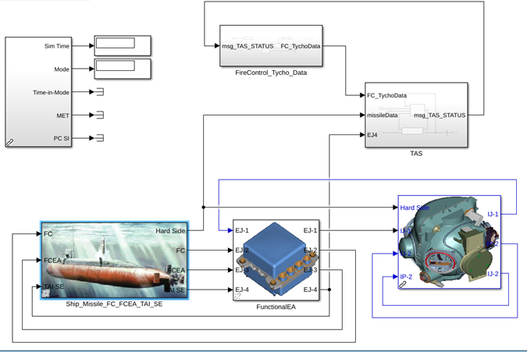
SWS MBE Virtual Environment Simulation
Expansion of current Guidance virtual environment to include avionics subsystems and shipboard:
SWS Avionics C&R verification and test
Full Nav Data, RB alignment simulation and status, Flight Control simulation
Distributed development & early integration between locations
Network Switch
Tactical
Playback Data
RB
Simulation

Slide 43
More Backup

Slide 44
Internal Comms Physical Layer Overview
Took measurements of existing slip rings with VNA to use for modeling
Simulated internal comms physical layers with LE slip rings and transformers.
Created a test bench to test candidate physical technologies with existing LE slip rings
Evaluated several physical layer technologies and will continue to evaluate
Working on several FPGA Mezzanine Card (FMC) designs to stress test comms system for long periods of time and with additive noise
Created Pseudo Random Bit Sequence (PRBS) -> 8B10B HDL generation and checker for running above bulleted point. Can then apply noise to this environment with current clamps.
Added special control characters into the data stream to test extraction of SYNC from data
Developing the HDL for a new comms system. Currently working on block diagrams for concept.

Slide 45
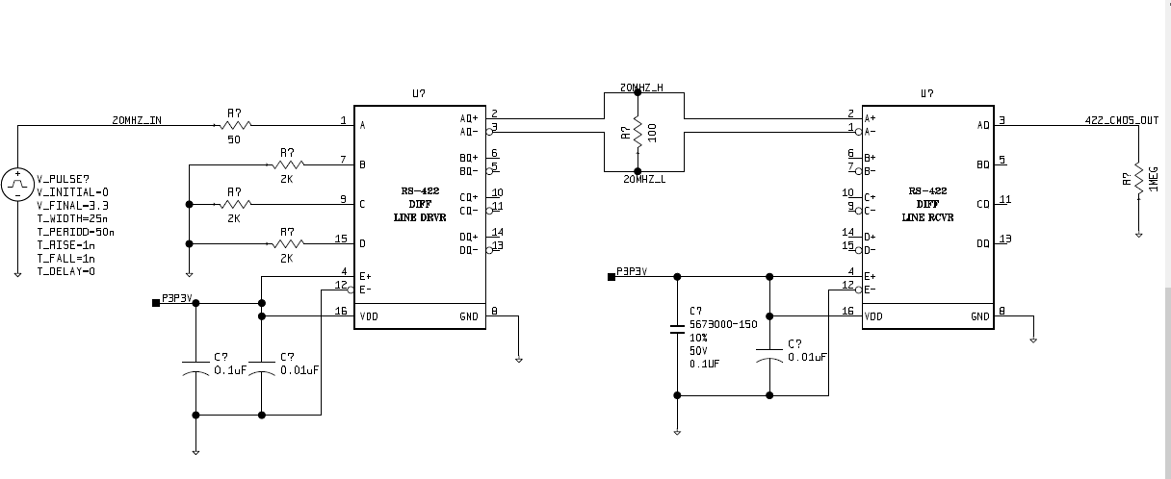
RS422 Modeling - Mentor AMSVX2.8 using MOD_5672982 and MOD_5672983
MOD_5672983
MOD_5672982

Slide 46
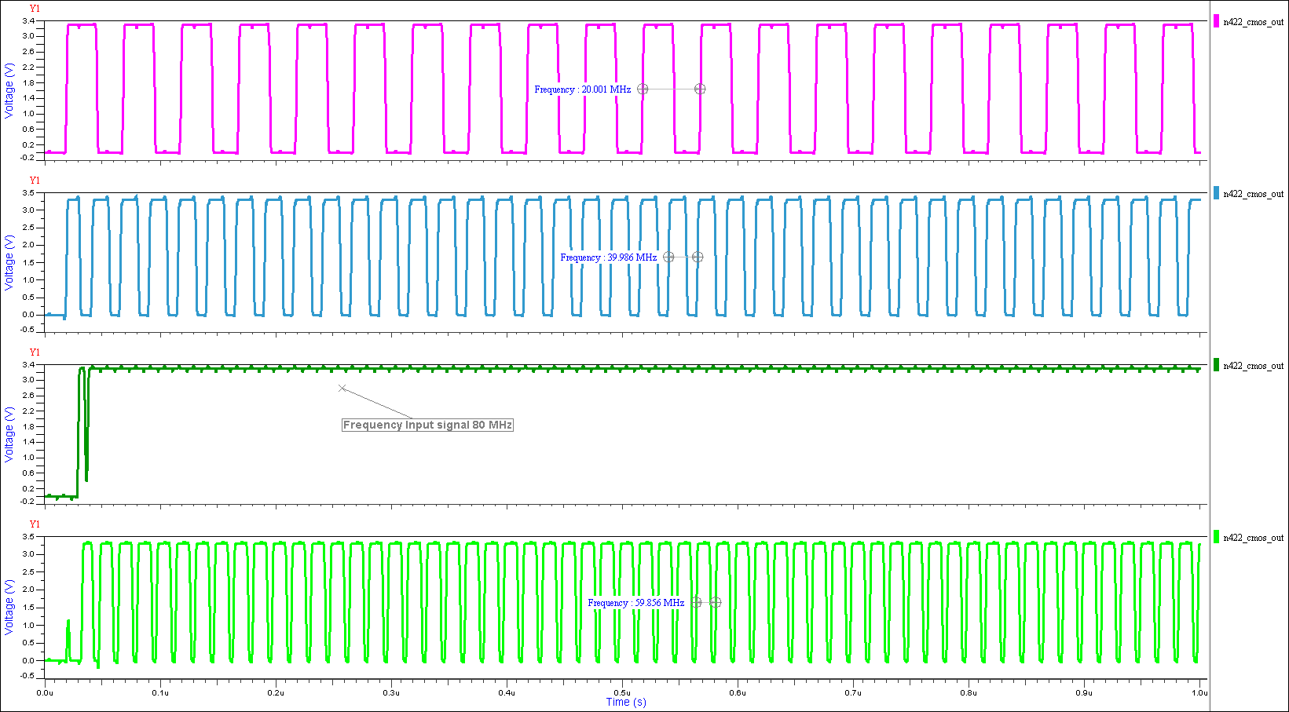

Slide 47
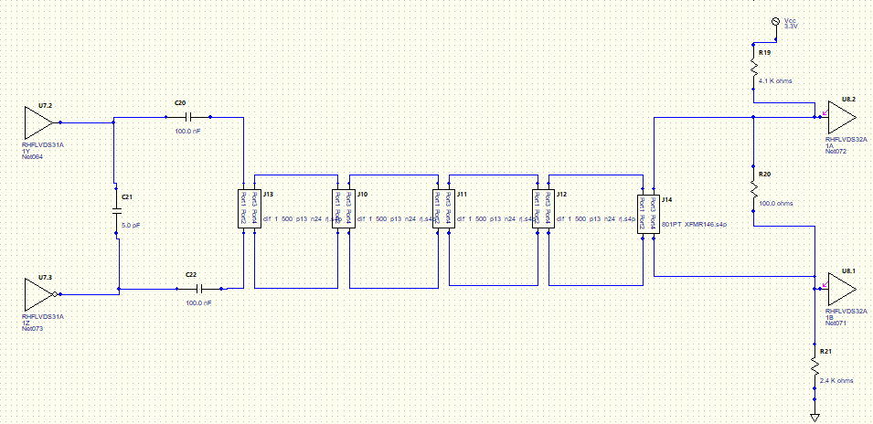
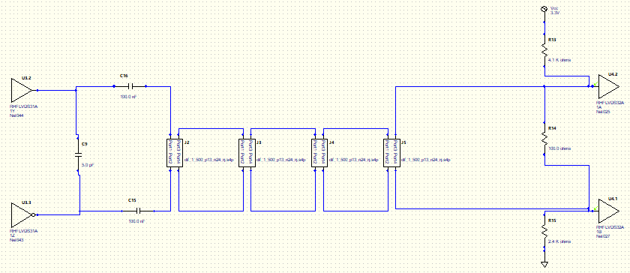
Hyperlynx Circuit LVDS TX and LVDS RX
There are 4 slipring models used in this circuit that are modeled using touchstone files created from measured sliprings
The signals are AC coupled using capacitors and biased using the voltage divider on the right
The driver is the ST-Micro RHLVDS315 and the receiver is the ST-Micro RHLVDS325 which are both tested to space radiation standards
The top circuit includes xfmr coupling while the bottom doesn’t

Slide 48
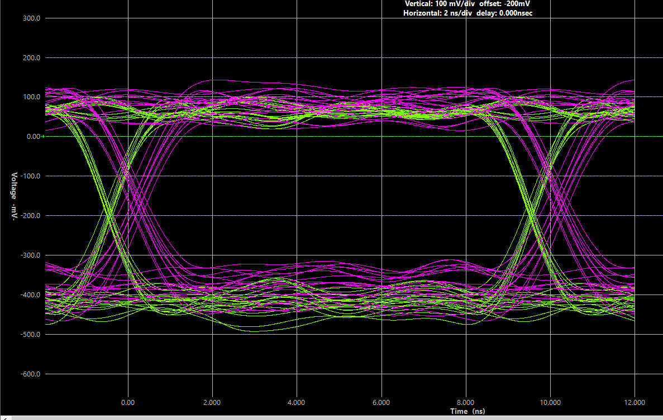
Hyperlynx Simulation
The eye diagram is run at 100Mbps using PRBS-7 with 8b10b encoding
Pink is with transformer coupling and green is without
The transformer coupling closes the eye slightly and adds some delay
Transformer used is lower BW model up to only 200MHz
Currently measuring new transformer model that goes to 375MHz

Slide 49
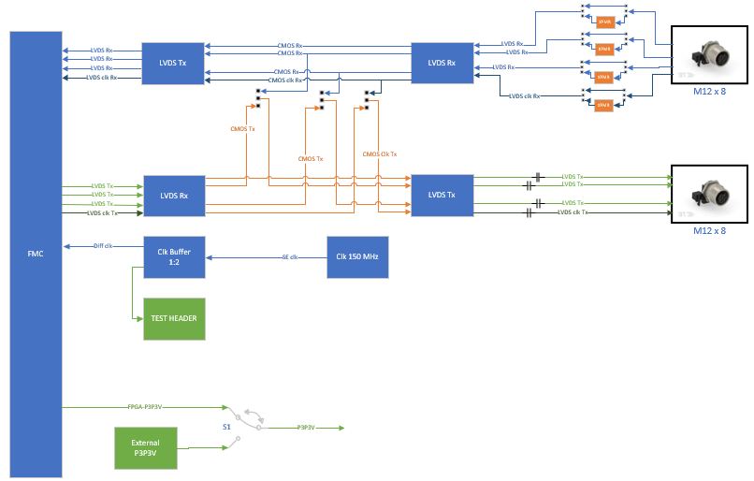
Physical Layer FMC Design
Designed with the Internal Comms High Level Concept 1 in mind
Schematic complete. Moving on to LRR. Working on alternate design with LVPECL.
FMC will be used to test the limitations of LVDS through the existing slip rings as well as xfmr and capacitor AC coupling
Three channels for passing data (PRBS with 8b10b) and one for passing the clock
Uses a source synchronous 150Mhz clock which is divisible by 2400Hz (existing rate)
Clock can be divided in FPGA
Ability to bypass xfmr with jumpers evaluate the need for xfmr AC coupling
LVDS Chips use a common pinout/footprint so many parts can be tested on the same board
Ability to bypass the FPGA with jumpers to simulate data moving through multiple regions with a redrive
LVDS chips can be powered at voltage minimums for margin analysis
Alternate transmission protocol being evaluated :
LVPECL – has a larger differential amplitude swing than LVDS increasing the slew rate at the receiver and lowering the jitter

Slide 50
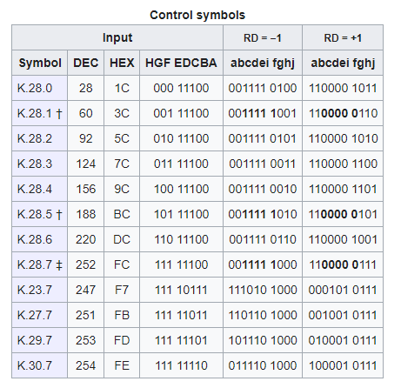
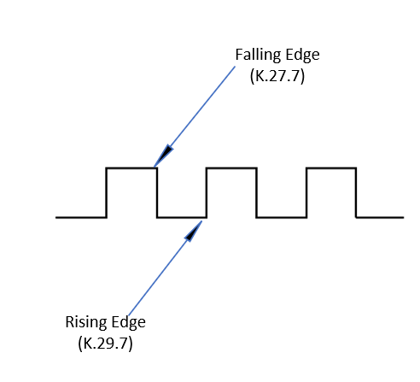
Using Control Symbols to Create Sync
Control Symbols are 10-bit special characters that do not have a corresponding 8-bit character.
They are unique and can be used for low level control functions as shown below.

Slide 51
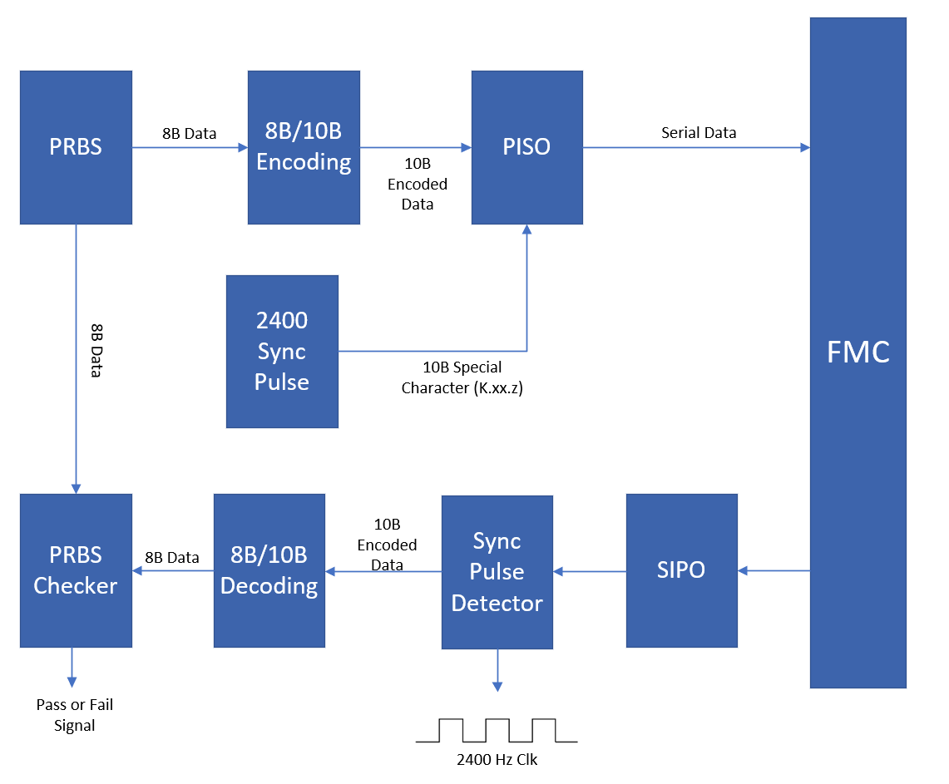
PRBS Sync Insertion and PRBS Checker
PRBS provides large dataset to stress system and test all data points
Control Symbols (K.XX.Z) sent at rising/falling edge of 2400 clock
PRBS data and special characters are sent through the same wire
Sync Pulse Detector, detects control symbols and removes it from data stream while triggering clock edge switch
PRBS Checker ensures the data was received correctly

Slide 52
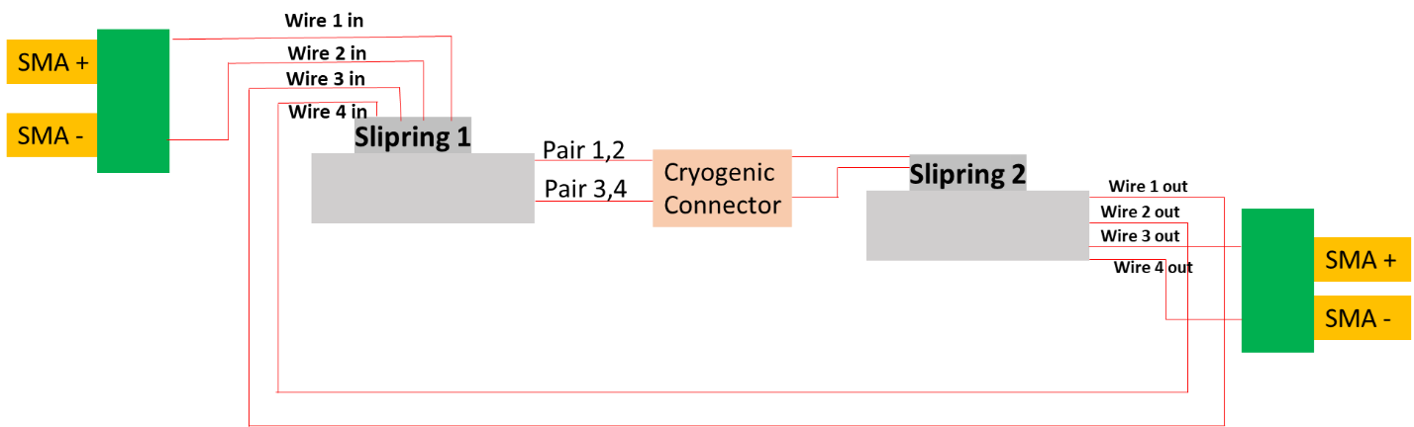
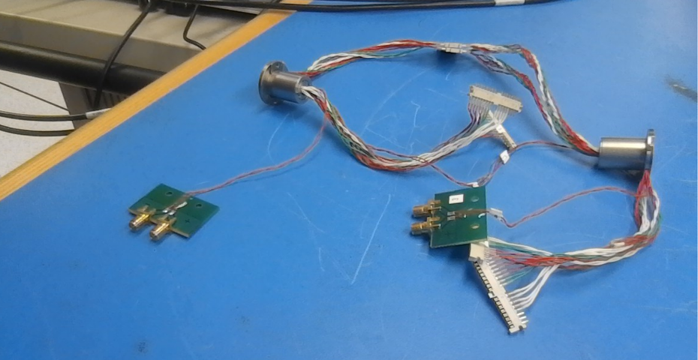
Rotary Joint assembly - 2 Slipring in the Loop
Equivalent of 4 slip rings made from 2

Slide 53
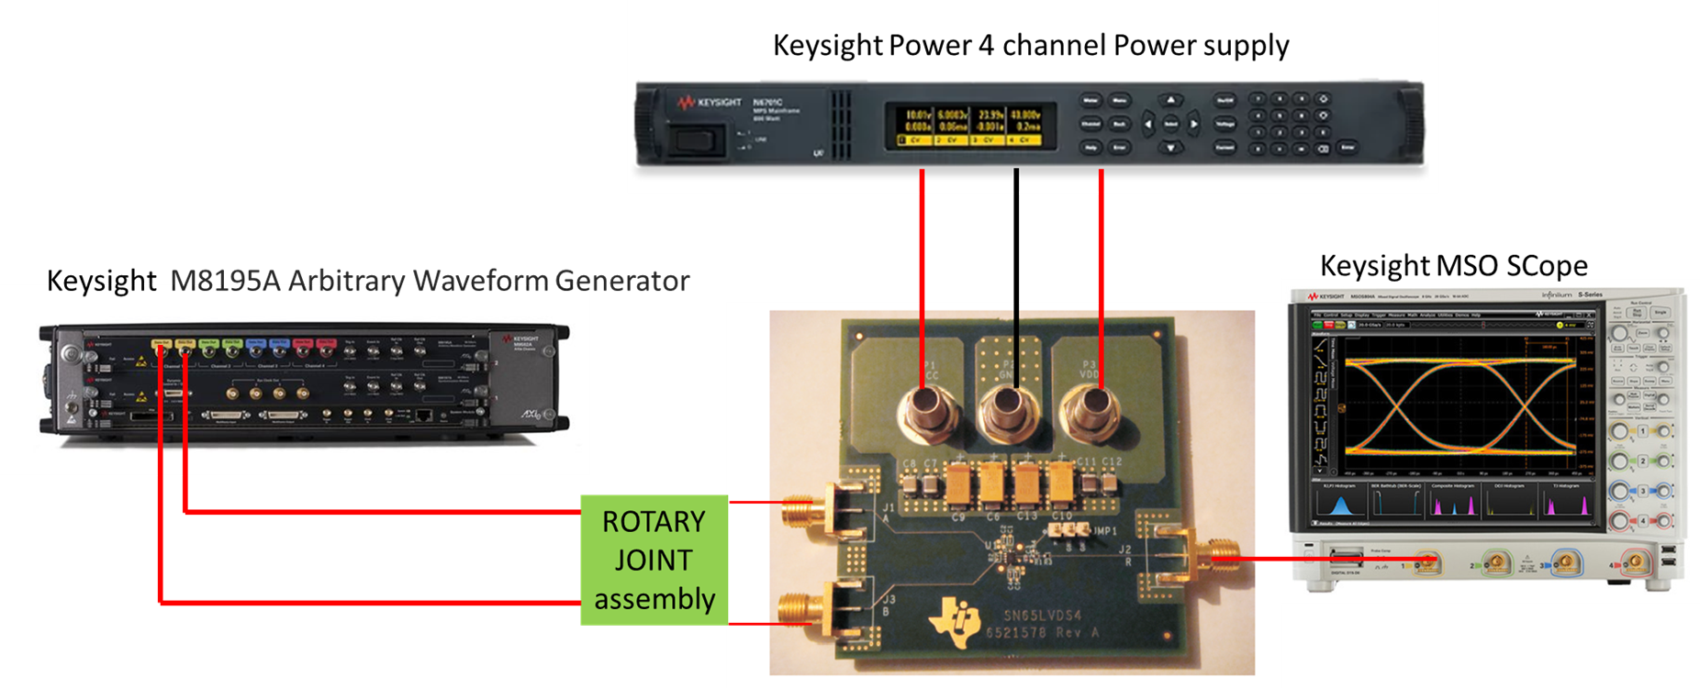
Experimental Set up to evaluate LVDS receiver
Initial evaluation, will use FMC board once completed

Slide 54
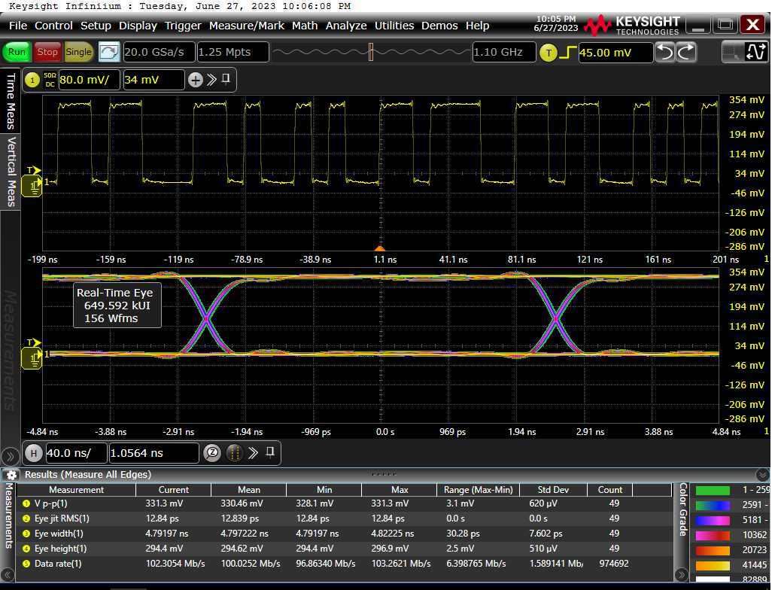
Typical results obtained with a 100 Mb/s 8b/10b PRBS7 encoded pattern on without slipring assembly
Eye Jitter (RMS):12.84 ps

Slide 55
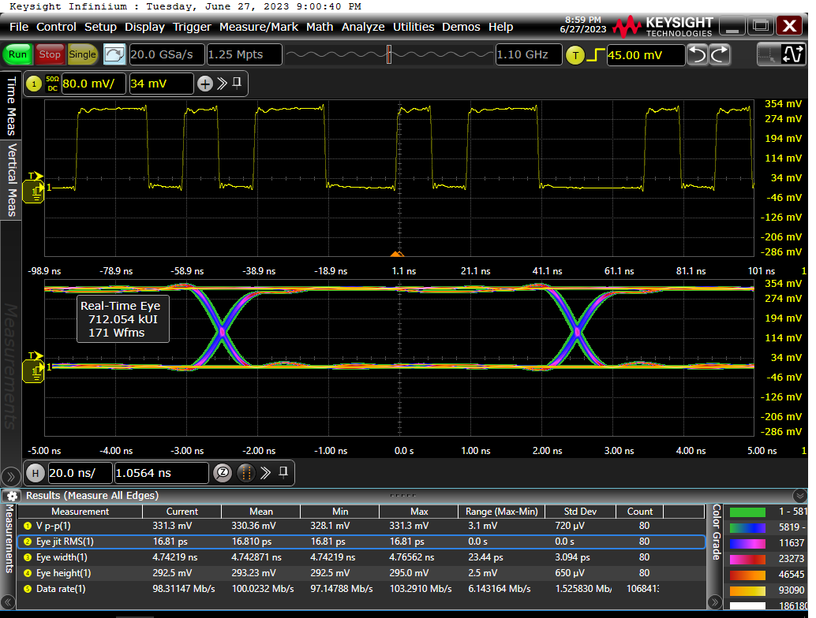
Typical results obtained with a 100 Mb/s 8b/10b PRBS7 encoded pattern through 4 slip rings
Eye Jitter (RMS):16.81 ps

Slide 56
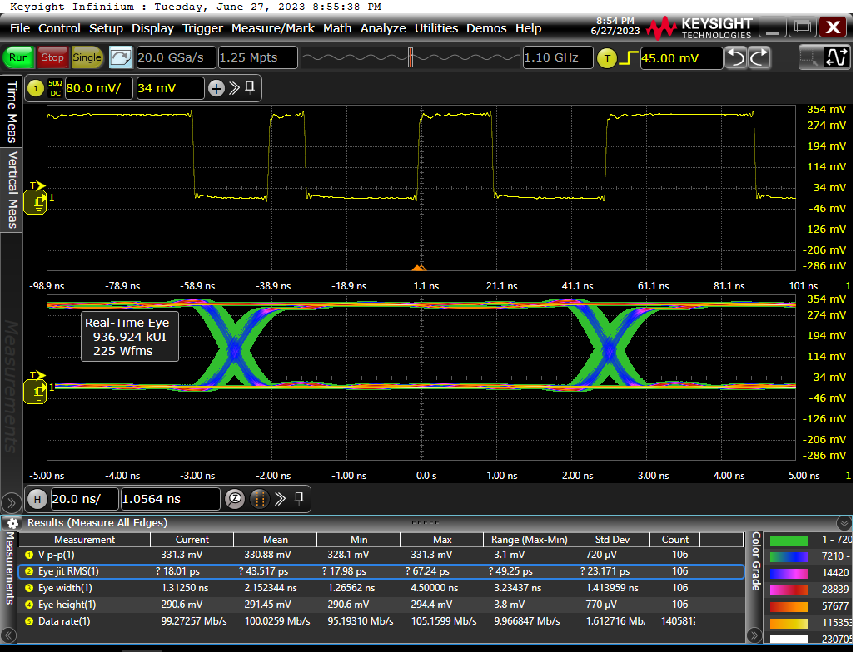
Results obtained with an 100 Mb/s with 4 slip rings with added jitter 0.05RJ pp
Eye Jitter (RMS):43.51 ps

Slide 57
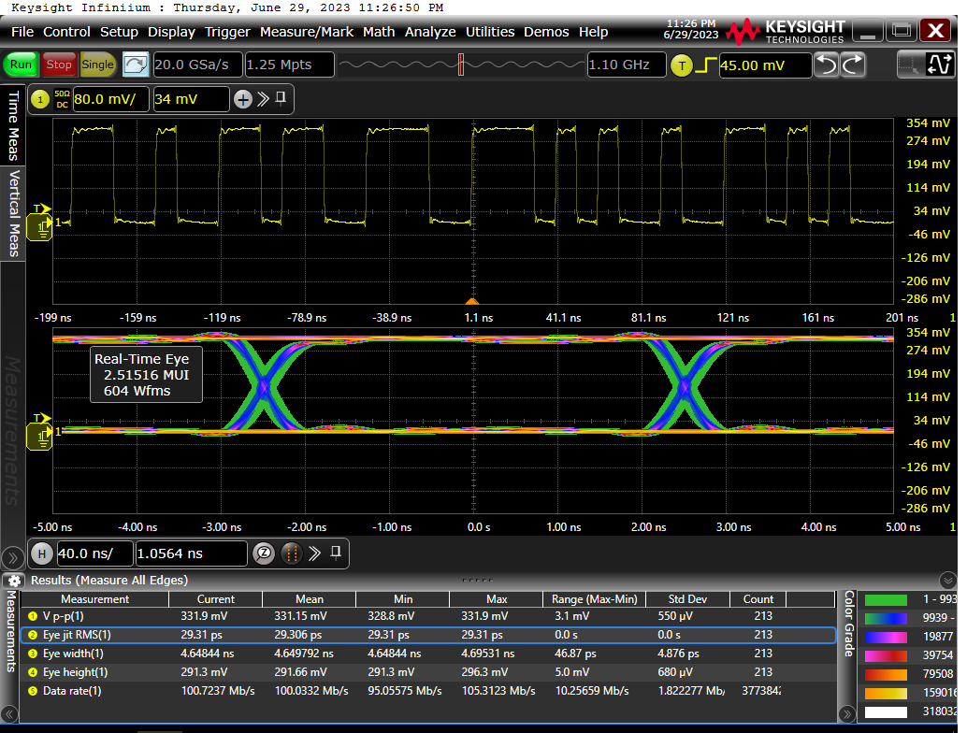
Typical results obtained with 100 Mb/s 8b/10b PRBS7 encoded pattern on without slipring assembly
No Transformer
With Transformer
Eye Jitter (RMS):12.84 ps
Eye Jitter (RMS):29.31 ps

Slide 58
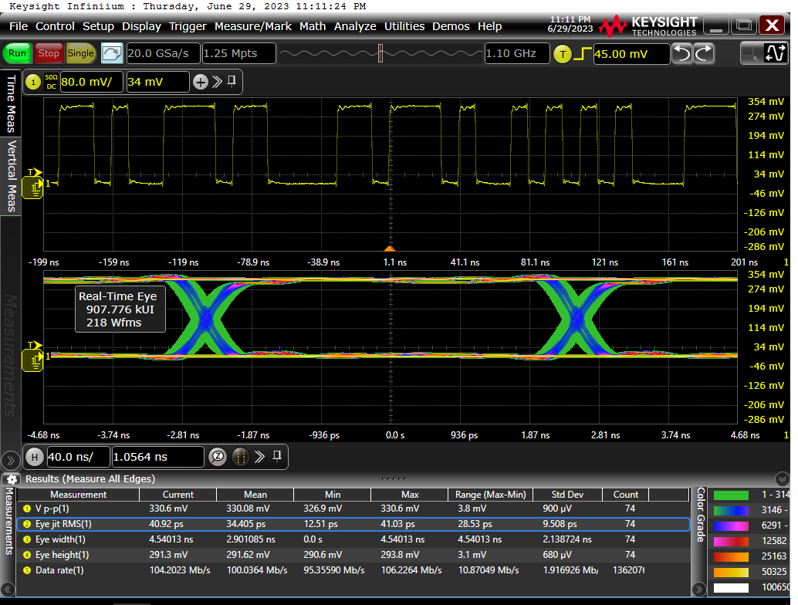
Typical results obtained with an 100 Mb/s 8b/10b PRBS7 encoded pattern with 4 slip rings
No Transformer
With Transformer
Eye Jitter (RMS):16.81 ps
Eye Jitter (RMS):34.4 ps

Slide 59
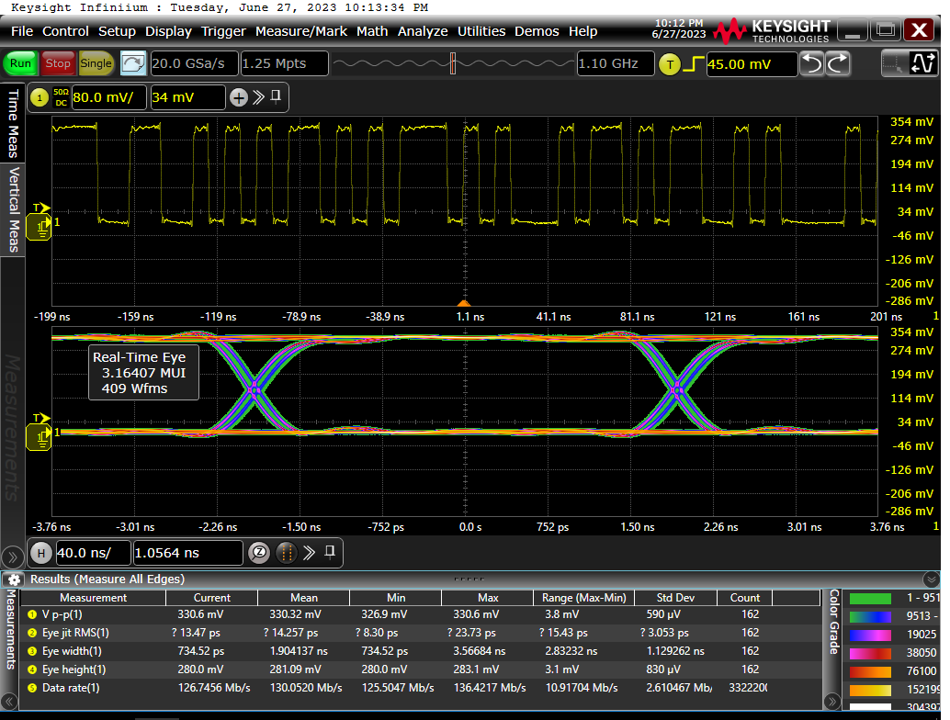

Results obtained with a 130 Mb/s 8b/10b PRBS7 encoded pattern with and without 4 slip rings
WITH RJ assembly
NO RJ assembly

Slide 60
HDL Communications Block Diagram

Slide 61
HDL Comms Block Detail Diagram

Slide 62
Avionics Protocol Summary 1
Point to point protocols:
Aurora8B10B – open standard developed by Xilinx available for implementation by anyone. We have used extensively and is a very robust point-to-point interface with fast recovery. Can be run over copper or fiber.
Interlaken – open specification implemented in some Xilinx FPGAs. Channelized chip-to-chip.
Bus protocols:
CAN – not suitable for strategic rad hard environments and lacks necessary bandwidth. Special physical layer transceiver.
1553 – low bandwidth with high protocol overhead. Bulky transformers. Greater number of nodes = less bandwidth for everyone.
EtherCat – uses Ethernet physical layer with ethernet MAC. MAC has customization. Messages pass through each system daisy chained.
Other
SpaceFibre – Builds on SpaceWire and physical layer is fiber. IP available for licensing.

Slide 63
Avionics Protocol Summary 2
Ethernet Technologies:
Vanilla switched Ethernet at 1,10 gigabit. Present in every computer. Hardware is inexpensive. Can be run over Fiber or Copper
TTE – Proprietary protocol that uses Ethernet. Company will not share source code. Used on Dream Chaser
Time Sensitive Networking (TSN) – New IEEE standard that combines VLANS, QoS and PTP for deterministic Ethernet. Requires specialized switches and hardware
ARINC 664 – Customization used for aircraft Ethernet Fly-by-wire. Requires specialized hardware and firmware
Ethernet Support Protocols:
DDS – Publish/Subscribe. DDS Cert has undergone DO-178C, IEC 61508, IEC 60601/IEC 62304, and ISO 26262 certification. All code provided.
LCM – Lightweight Control and Marshalling Protocol. Developed by MIT for low latency, high bandwidth systems
SNMP – Simple Network Management Protocol – Could be used for asynchronous messages indicating a problem/degradation of the system
“Something like DDS or LCM is a super good idea for Guidance” – John Lupien

Slide 64
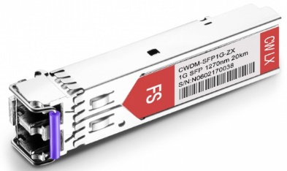
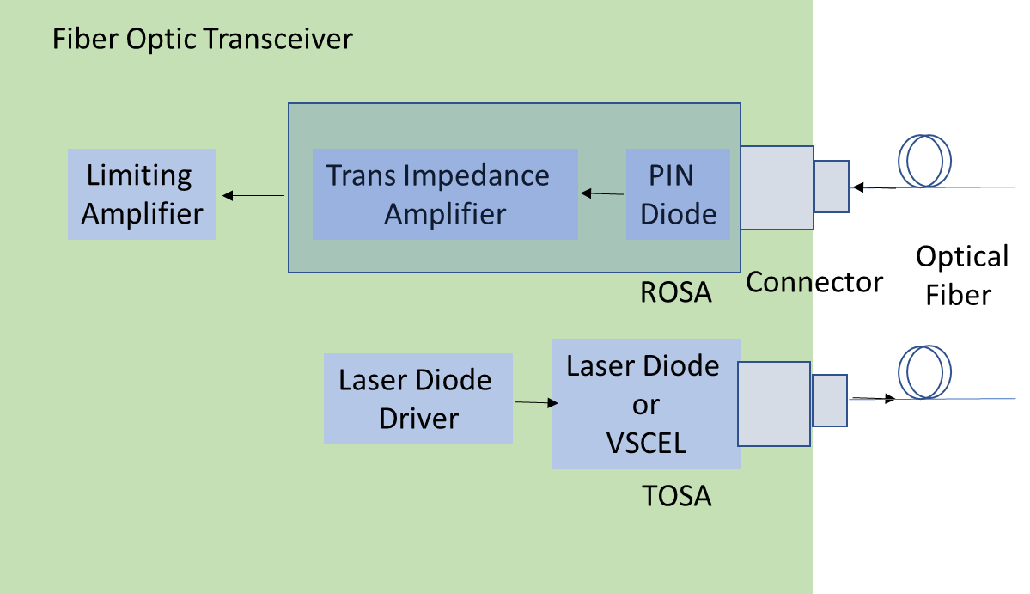
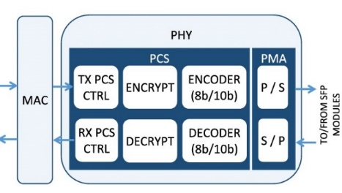
Fiber Optic Transceiver
Equivalent to Small Factor Pluggable (SFP) network interface module
Processor
(GradSOC)
1000BaseX RX
1000BaseX TX
Risk areas associated with Fiber Optics:
Radiation Hardness of transceiver
Turn on time of transceiver after PFI
Mechanical integrity of missile environment. (shock/vibe, cleanliness)

Slide 65
COTS Space Rad Hard Transceiver
Model | Vendor | Rad | Vib | Circumvention Time | Commercial Maturity | Form Factor | Optical Specs | Data Rate | Power Monitoring
FireHawk | Samtec |  |  | <1.2ms |  | Quad XCVRPCB Mount | 850, MMF | 1/10Gbps | Yes, SPI
AVMM2 | AirBorn* |  |  | 100ms |  | Quad XCVR Active Cable Assemby | 850, MMF | 1-10Gps/per channel | Yes, I2C
All transceivers require additional test data for Dose Rate. Radiation tests reviewed by Bill Schmitt
Startup/Recovery time is long in AirBorn transceiver due to Average Power Control (APC) control loop. Operate Through?
Samtec did not have thorough radiation test reports like . Unsure if Samtec will meet Neutron requirement.
Detailed data regarding test radiation, vibration and environment are available online. Full reports will be available pending NDA
Airborn published Burn-in results (MIL-STD-883): 240 hours minimum at 125C
Meet Requirements
May Meet Requirements
Further Evaluation Required
Does Not Meet Requirements
Notes:
Provide details in same sequential order for each technology.

Slide 66
COTS Fiber
Name | Vendor | Radiation induced attenuation -RIA (db/100m) | Fiber Type | Commercial Maturity | Core Attenuation (db/Km)
GR-50/125-23HTA | Coherent* | "Radiation-hard" | MMF |  | 3.5@850nm 1.2@1300nm
RadHard 50µm BendBright | Prysmian Group | 7.5 @ 1300nm** | MMF |  | 2.5@850nm 0.7@1300nm
Super RadHard | Prysmian Group | 4.7@ 850nm*** 2.2@ 1300nm | MMF |  | 2.6@850nm 0.6@1300nm
Corning and Prysmian found on Navy Shipboard Fiber Optic List. Coherent fiber used in IFOG
Need actual data from manufacturers
Meet Requirements
*IFOG Rad tests available for Single mode Coherent fiber
** Corning and Draka ( part of Prysimian Group now) on Navy Shipboard recommended Fiber optic list
** Dose 10kGy, Dose Rate 1.67Gy/s, Temperature 28C
*** Dose 2MGy, Dose Rate 1.25Gy/s, Temperature 45C
May Meet Requirements
Further Evaluation Required
Does Not Meet Requirements
Notes:
Provide details in same sequential order for each technology.

Slide 67
COTS Optical Connectors
Name | Type | Vendor | Vibe | Commercial Maturity | Insertion Loss | Mating Cycles
MT Ferule Fiber Optic | High-density MT ferrule in MIL-DTL-38999 connector | Glenair* | MIL-STD-1678-3 |  | 0.5 dB (50/125) 0.3 dB (9/125) | 500 per TIA-455-21A
183-003 Series 79 MT | High-density MT ferrule in series 79 rectangular connector | Glenair** | MIL-STD-202, MIL-STD-833E |  | 0.31 dB (850 nm) 0.38 dB (1300 nm) | 500
180-132 GFR | Glenair front release in D38999 connector | Glenair*** | No public info |  | < 0.5 dB | No public info
JBDL262ABFAZ-OL-MIL | Circular expanded beam connector MIL-DTL-83526 | Fibreco | MIL-DTL-83526/20 /21 |  | 1 dB | 3000
1900Elio / ABS1696 | Rectangular Elio Socket, 7 optical termini slot | Amphenol | 3 kHz, 20 g, 12 hours |  | Less than 0.3 | 500
Final connector choices will depend on mating cycles and overall link budget margin
Connectors will need to be tested for high shock experienced during stage separation
*MT ferrule
** Rugged small factor utilizing MT optic ferrules , 500 mating cycles
*** Used for tactical applications
ALL PARTS bellowed SPACE Hard according to vendor
Meet Requirements
May Meet Requirements
Further Evaluation Required
Does Not Meet Requirements
Notes:
Provide details in same sequential order for each technology.

Slide 68
Fiber Optic Testing

Slide 69
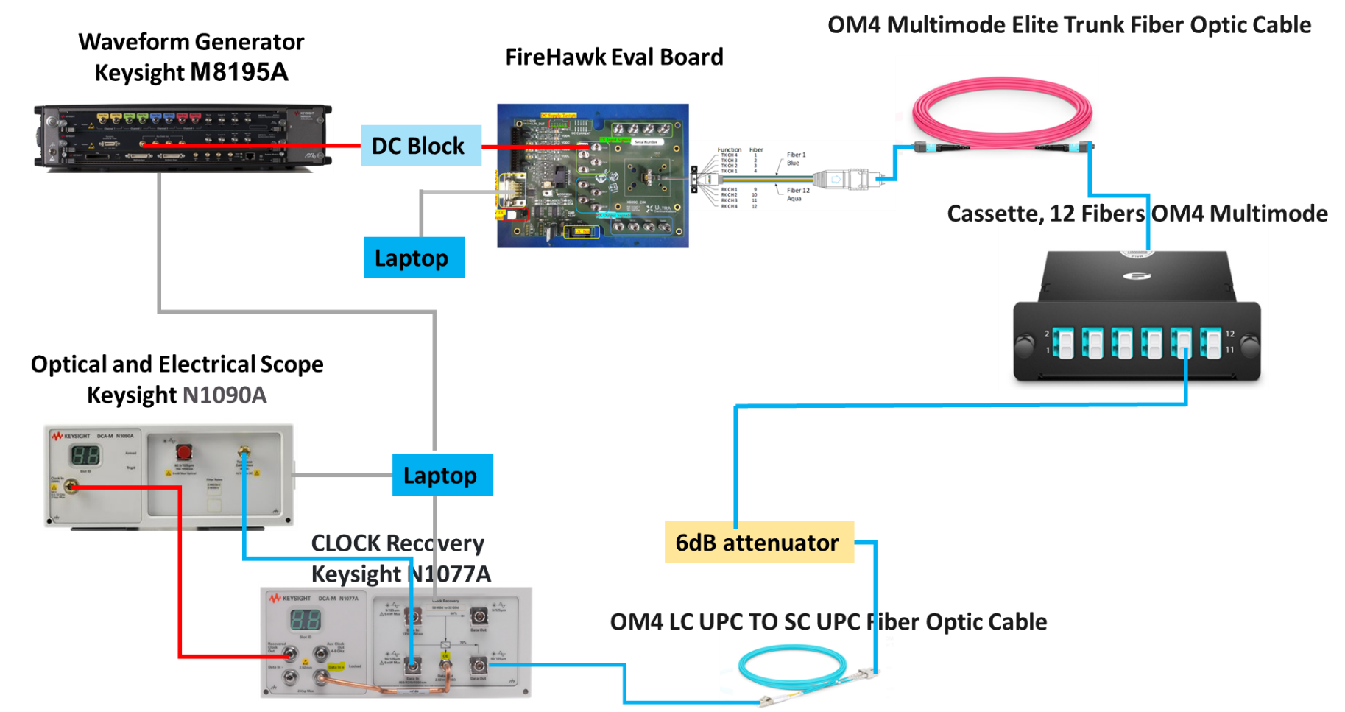
Setup for Testing FireHawk Samtec Optical Transceiver

Slide 70
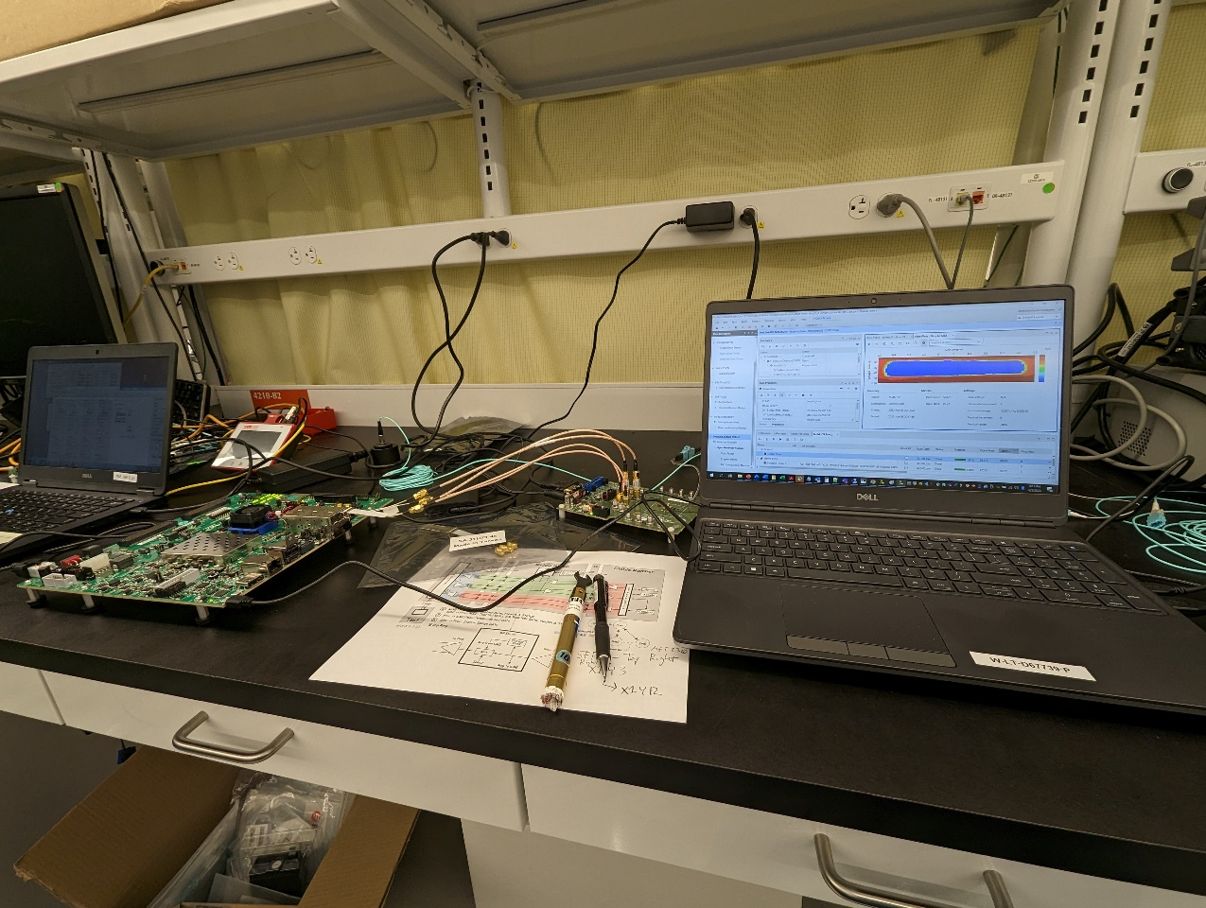
Xilinx iBert
Using the Xilinx built-in iBert we can run PRBS-7,23,31 for days or weeks on end and check for any single error.
Already ran fiber optic transceiver for 6 hours with no errors reported. I suspect I could run for a week with no errors. Will test.
Xilinx iBert allows direct control of electrical transceiver to adjust pre-emphasis, equalization, voltage output levels.
Can be run with optical in loopback with characteristic cable loss specs
Can be run in a vibration environment
Provides electrical margin review

Slide 71
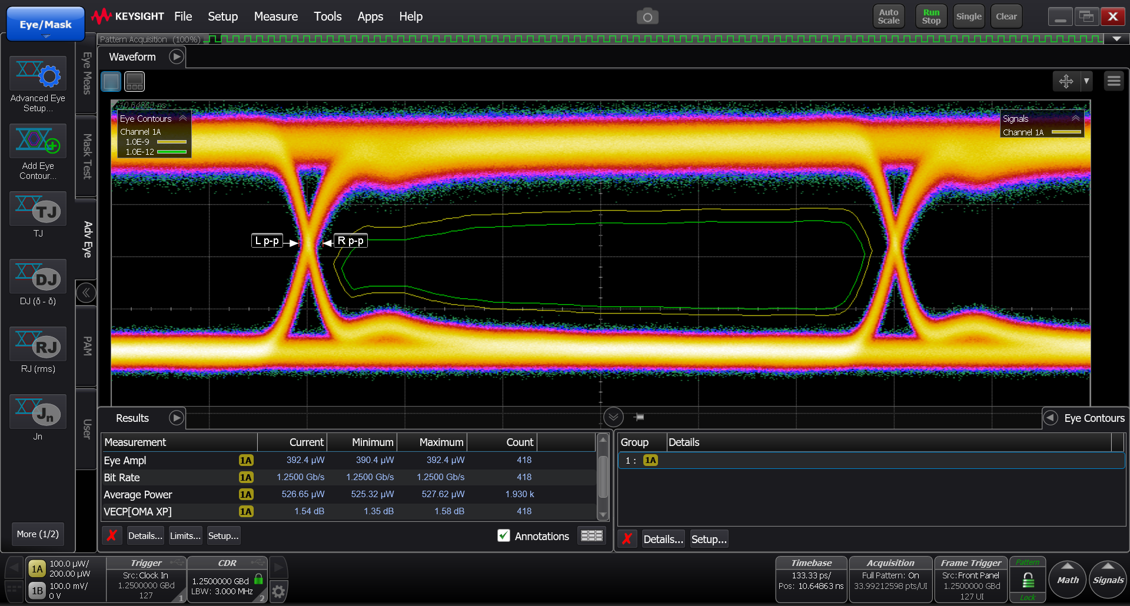
Measurements on FireHawk Samtec Optical Transceiver

Slide 72
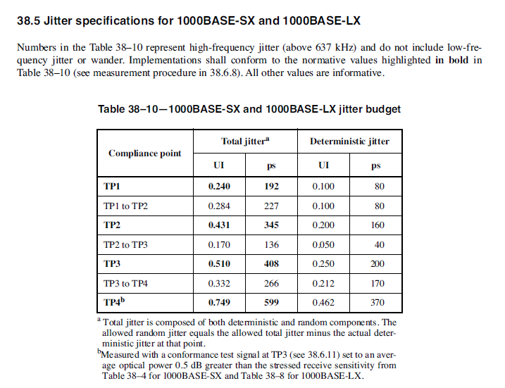
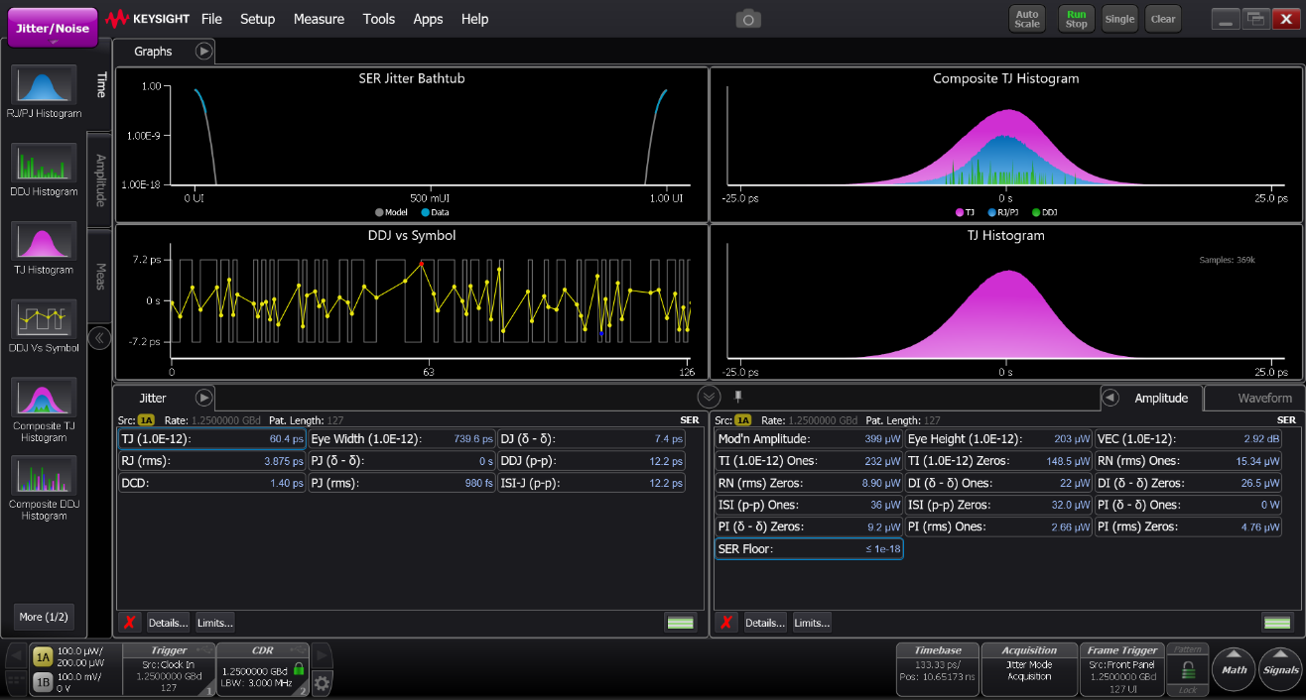
Measurements of Samtec Firehawk Optical Transceiver (Jitter Analysis)
Samtec Measured TJ = 60.4 ps
1000 BaseSX- TJ : 192ps

Slide 73
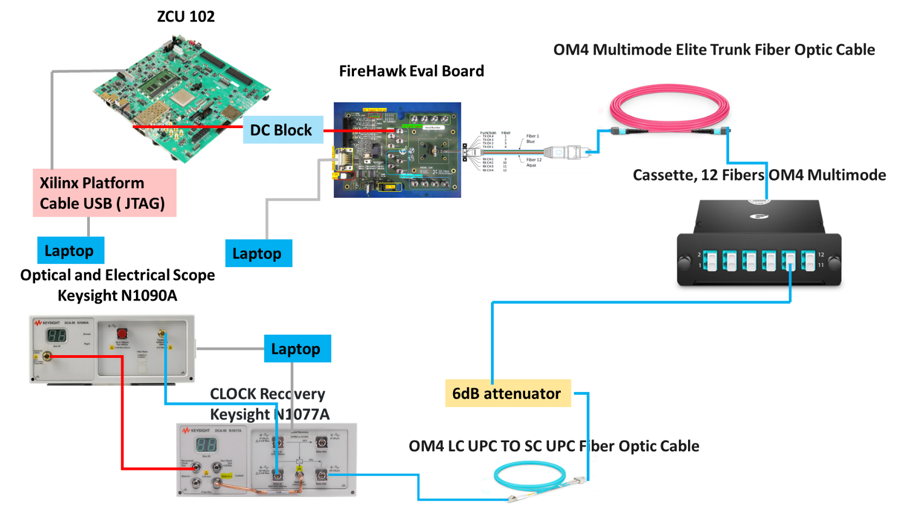
Setup for Testing FPGA BERT implementation

Slide 74
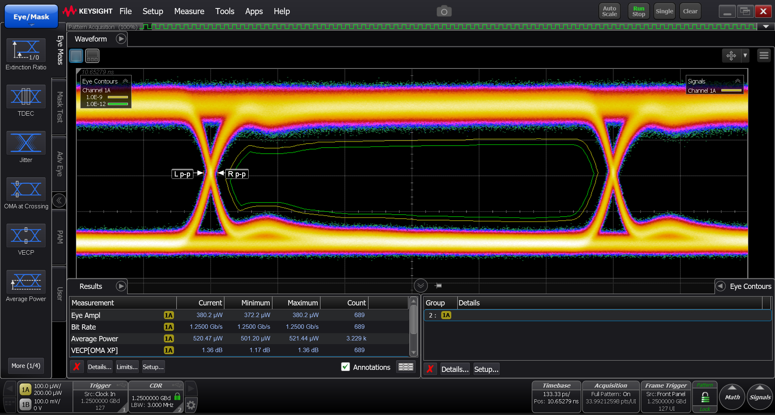
Measurements on FireHawk Samtec Optical Transceiver (FPGA BERT implementation)

Slide 75
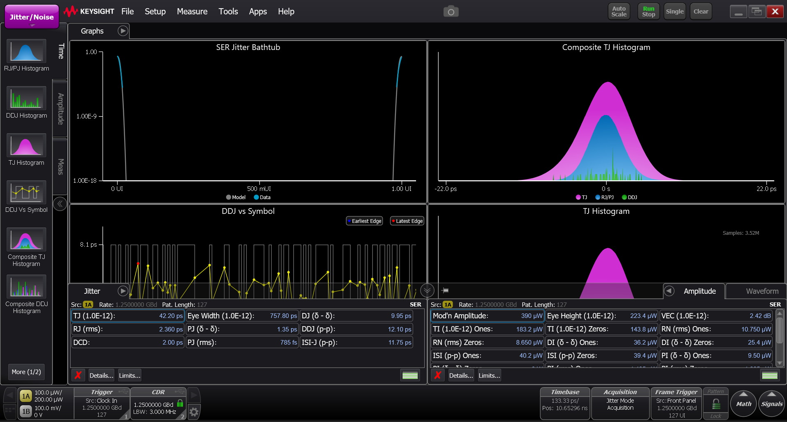
Measurements on FireHawk Samtec Optical Transceiver (Jitter Analysis)- FPGA BERT implementation
Samtec TJ = 42.26 ps Only AWG TJ= 29.91 ps

Slide 76
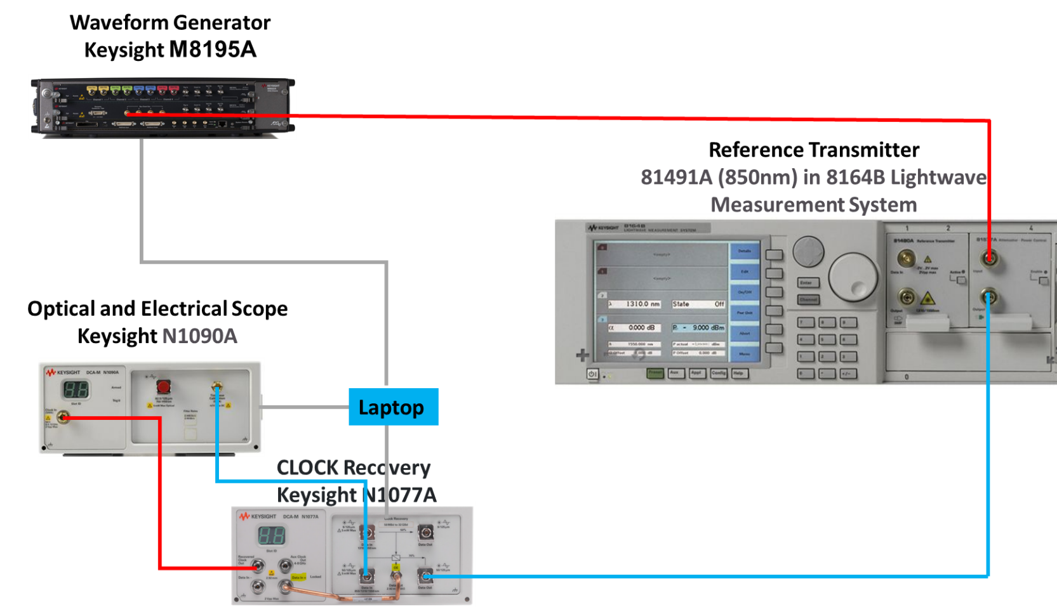
Setup for Baseline Testing

Slide 77
Middleware Timing Measurements

Slide 78
DDS Testing Measurements
Current test setup:
Using RTI’s latency test
Measures round-trip time between a publisher and subscriber
Publisher sends packets, Subscriber echoes them
Publisher calculates average round-trip time over 100000 packets for each of 9 sizes
Linux-based Laptop host running Latency Publisher
ZCU-102 running FreeRTOS and LWIP running Latency Subscriber
Communicating over fiber ethernet
Using RTI Connext DDS Micro 2.4.14 for testing purposes
This version is the basis of RTI Connext DDS Cert.
Connext DDS Cert has undergone DO-178C, IEC 61508, IEC 60601/IEC 62304, and ISO 26262 certification.
Subscriber running on ZCU-102 has been instrumented
Added GPIO output to break down “user-space” processing versus time used by DDS
Laptop
ZCU-102
Scope
Latency
Publisher
Latency
Subscriber
Fiber
Ethernet
Switch
GPIO

Slide 79
DDS Testing Measurements
Timing outputs based on GPIO Pin 0
Output set HIGH when an ethernet packet is received.
Output set LOW at the beginning of ‘user-space’ processing
Output set HIGH when DDS send function called
Output set LOW after packet send complete.
DDS Rx Processing
DDS Tx Processing
Application Processing

Slide 80
DDS Timing Measurements
Packet Size (bytes) | DDS Rx Time (us) | Proc Time (us) | DDS Tx Time (us) | Total Sub Time (us)
16 | 22.27 | 6.30 | 24.63 | 53.20
32 | 22.36 | 6.40 | 24.70 | 53.46
64 | 22.30 | 6.40 | 24.60 | 53.30
128 | 22.40 | 6.44 | 24.92 | 53.76
256 | 22.54 | 6.54 | 24.88 | 53.96
512 | 22.52 | 6.74 | 24.84 | 54.10
1024 | 24.00 | 6.93 | 25.33 | 56.27
2048 | 23.34 | 7.50 | 31.26 | 62.10
4096 | 24.16 | 8.51 | 35.24 | 67.91
DDS Reported latency is latency reported by the Publisher on Linux Laptop after processing
Numbers are very stable & repeatable on ZCU-102
Performance with Publisher on a ZCU-102 is expected to be similar to Subscriber
Comms on publisher are essentially doing the same thing as subscriber

Slide 81
Demo Setup
Test of all internal and external comms working simultaneously
Simulated Data based on LE

Slide 82
Backup

Slide 83
Avionics Network Systems Approach Highlights
Managed Systems Communication Approach
Tactical Timelines
Coordination, Interface and Data
Rad Hard and Circumvention and Recovery
Test Integration
SWS MBE Virtual Environment Simulation
Cyber Authentication and Test Analysis

Slide 84
Managed Systems Communication Approach
DETERMINISTIC
NON-DETERMINISTIC
ADVANTAGES:
Easier reproduction of errors for development and fleet support
Defined set of V&V test vectors
Flexibility for technology upgrades, reallocation, or future node insertions
Consistent Network Communications rules throughout
distributed system
DISADVANTAGES:
Communications structure and rules need to be established
ADVANTAGES:
Application transparent to communications infrastructure
Simple use on demand protocol
DISADVANTAGES:
Poor reproducibility of errors
Requires coordination between applications to minimize effects of system bottlenecks
Infinite set of V&V test vectors
Application Designers would each implement their own API and would establish their own intercommunication standards (much like current COORD)
Deterministic timing is a function of performance capabilities of system
Poorly defines structure for mapping application
Possible detailed analysis required for new technology or application reallocation
A Deterministic Approach to Communications Provides a
Strong Scalable Structure for LE2 Design and Future Enhancements

Slide 85
Tactical Timelines
Initial numbers indicate less than 10% for all tactical timelines

Slide 86
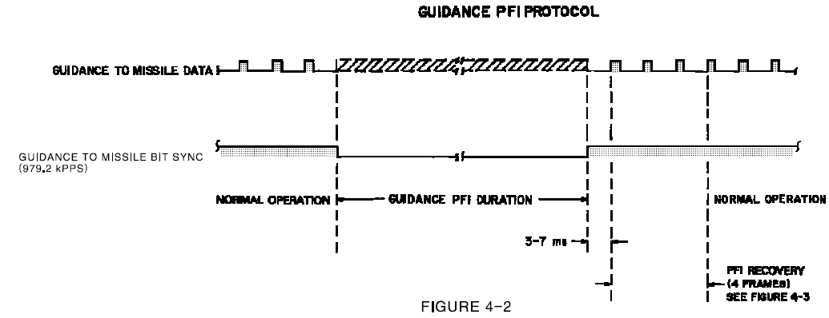
Rad Hard & Circumvention and Recovery (C&R)
Hardware Transceiver and PHY implemented in Processor will require testing
Guidance is master of communications, modes, and states to RBs and Flight Control
If Flight Control is integrated with guidance, then C&R is handled intrinsically
If Flight Control is external to guidance, then some independent discrete may be needed
RBs may need independent discrete to indicate C&R (TBD)
Current Indications are that boot time of comms hardware, processor, and stack will support the 3ms recovery time.
Current FCEA Timeline

Slide 87
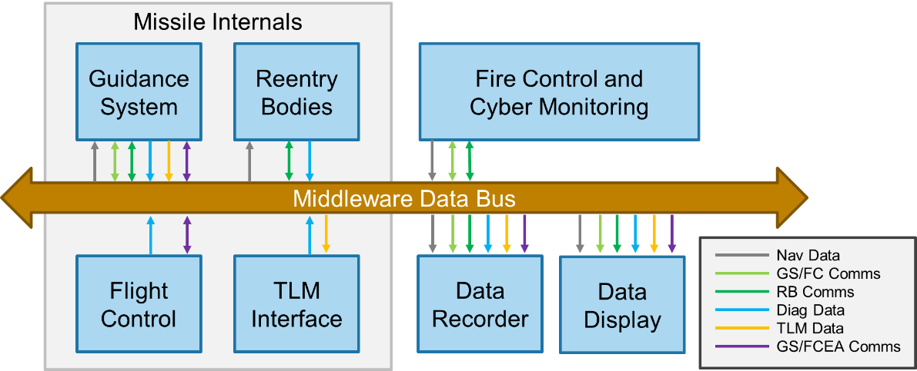
Cyber Authentication and Test
Authentication for all network nodes
Network will allow for addition/subtraction of authorized test equipment and data display
Constant network monitoring for intrusion of not allowed network devices connected to network
Monitoring and logging of general health and welfare of the network
Test data logging to support to quick cyber response verification

